Slide 1
Overview of Algorithm

Slide 2
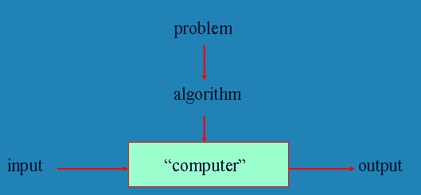
Overview of algorithm
To apply algorithm first of all there should be a problem that needs solution
  Is there any problem for which we can’t design algorithm?
  Program = Algorithm + Data Structure

Slide 3
What is an algorithm?
An algorithm is a clearly specified set of simple instructions to be followed to solve a problem
Any well-defined computational procedure that takes some value (or set of values) as an input and produces some value (or set of values) as an output
A sequence of computational steps that transforms the input into the output
A set of well-defined, finite rules used for problem solving
A finite set of instructions that, if followed, accomplishes a particular task
It is a precise, systematic method for producing a specified result

Slide 4
What is an algorithm?
An algorithm is a sequence of unambiguous instructions for solving a problem, i.e., for obtaining a required output for any legitimate input in a finite amount of time
From the above definition, algorithm has the following five properties: Sequence, Unambiguous, Input, Output, Finite

Slide 5
Properties of an algorithm: Sequence
It is a step-by-step procedure for solving a given problem
Every algorithm should have a beginning (start) and a halt (end) step
The first step (start step) and last step (halt step) must be clearly noted
Between the two every step should have preceding and succeeding steps
That is, each step must have a uniquely defined preceding and succeeding step

Slide 6
Properties of an algorithm: Unambiguous
Define rigorously the sequence of operations performed for transforming the inputs into the outputs
No ambiguous statements are allowed: Each step of an algorithm must be clearly and precisely defined, having one and only one interpretation.
At each point in computation, one should be able to tell exactly what will happen next
Algorithms must specify every step. It must be composed of concrete steps
Every detail of each step must be spelled out, including how to handle errors
This ensures that if the algorithm is performed at different times or by different systems using the same data, the output will be the same.

Slide 7
Properties of an algorithm: Input specified
The inputs are the data that will be transformed during the computation to produce the output
An input to an algorithm specifies an instance of the problem the algorithm solves
Every algorithm should have a specified number (zero or more) input values (or quantities) which are externally supplied
  We must specify the type of data and the amount of data
Note that, correct algorithm is not one that works most of the time but one that works correctly for all legitimate inputs

Slide 8
Properties of an algorithm: Output specified
The output is the data resulting from the computation
  It is the intended result
Every algorithm should have one or a sequence of output values
  There must be one or more result values
A possible output for some computations is a statement that there can be no output, i.e., no solution is possible
The algorithm can be proved to produce the correct output given a valid input.

Slide 9
Properties of an algorithm: Finiteness
Every valid algorithm must complete or terminate after a finite number of steps.
If you trace out the instructions of an algorithm, then for all cases the algorithm must terminate after a finite number of steps
  It must eventually stop either with the right output or with a statement that no solution is possible
Finiteness is an issue for computer algorithms because
  Computer algorithms often repeat instructions
  If the algorithm doesn’t specify when to stop, the computer will continue to repeat the instructions forever

Slide 10
Why need algorithm analysis ?
There are many ways to solve a given problem
  So writing a working program to solve a problem is not good enough
The program may be inefficient and/or incorrect!
If the program is run on a large data set, then the running time becomes an issue
Always we have to undertake algorithm analysis before implementation
Example: Selection Problem
  Given a list of N numbers, determine the k^{th} largest, where k ≤ N.

Slide 11
Example: Selection Problem
Algorithm 1:
  (1) Read N numbers into an array
  (2) Sort the array in decreasing order by some simple algorithm
  (3) Return the element in k^{th} position

Slide 12
Example: Selection Problem…
Algorithm 2:
  (1) Read the first k elements into an array and sort them in decreasing order
  (2) Each remaining element is read one by one
      If smaller than the k^{th} element, then it is ignored
      Otherwise, it is placed in its correct spot in the array, bumping one element out of the array.
  (3) The element in the k^{th} position is returned as the answer.

Slide 13
Example: Selection Problem…
Which algorithm is better when
  N =100 and k = 100?
  N =100 and k = 1?
What happens when N = 1,000,000 and k = 500,000?
Which one is an efficient algorithm? Correct algorithm?
  Is there exist better algorithms?

Slide 14
Algorithm Evaluation
Two main ways:
The Efficiency of the algorithm
  determination of the number of resources necessary to execute it, such as
    the number of steps or iterations (time complexity) or
    storage locations (space complexity).
  the efficiency or running time of an algorithm is stated as a function relating the input length to time and storage requirement
The Correctness of the algorithm
  We only analyze the efficiency of correct algorithms

Slide 15
Correct Algorithm
A correct algorithm solves the given computational problem
  If the algorithm is not doing what it is supposed to do, it is worthless
An algorithm is said to be correct if, for every input instance, it halts with the correct output
An incorrect algorithm
  might not halt at all on some input instances, or
  might halt with a wrong answer.
In order to show that an algorithm is incorrect, you need just one instance of its input for which the algorithm fails.
How to prove the correctness of an algorithm?
  Common techniques are by mathematical induction & contradiction

Slide 16
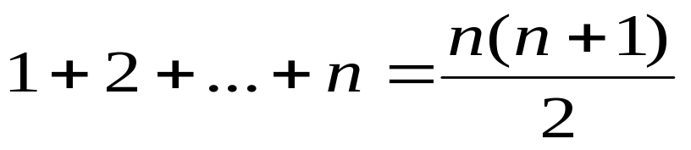
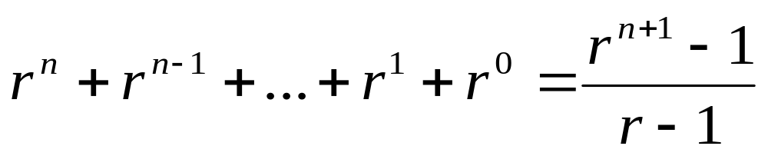
Proof by Induction
The induction base: is the proof that the statement is true for initial value (e.g. n =1)
The induction hypothesis: is the assumption that the statement is true for an arbitrary values 1, 2, …, n
The induction step: is the proof that if the statement is true for n, it must be true for n+1
Example: show the correctness of the following equation, for all positive integers n,
Assignment: proof by induction that the following geometric serious is correct:

Slide 17
Example 2: The sorting problem
One might need to sort a sequence of numbers into increasing order (Or decreasing order).
Statement of the sorting problem
  Input: a sequence of n number <a₁, a₂, …,a_{n}>
  Output: a permutation (reordering) <a₁', a₂', …,a_{n}'> such that a₁'≤ a₂' ≤ … ≤ a_{n} '.
Example:
  Given an input sequence <31, 41, 59, 26, 41, 58>, a sorting algorithm that arranges in non-decreasing order returns as an output the sequence
<26, 31, 41, 41, 58, 59>
How many sorting algorithms you know?

Slide 18
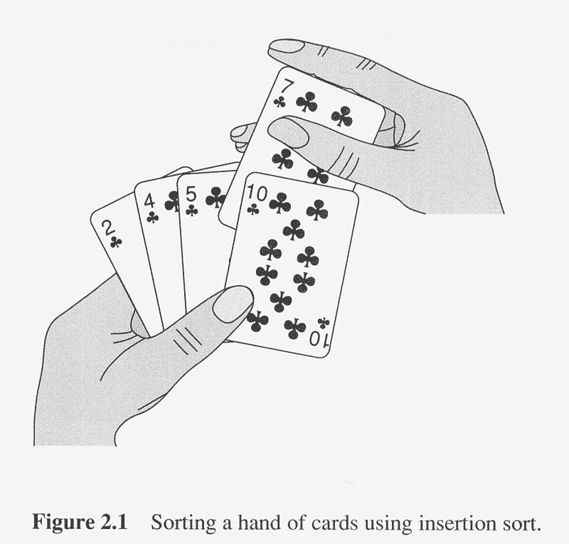
Example 2: Insertion Sort Algorithm
It is an efficient algorithm for sorting small-size datasets
  It is similar to sorting a hand of playing cards
Idea: Every time, take one card & insert the card to correct position in already sorted cards.
  We start with an empty left hand and the cards face down on the table. We then remove one card at a time from the table & insert it into the correct position in the left hand.
  To find the correct position for a card, we compare it with each of the cards already in the hand, from right to left as shown in the figure.

Slide 19
Insertion sort Algorithm
Principle: Starting from the beginning sort each member of the input by putting one by one in its proper position
Input: a sequence of n number <a₁, a₂, …,a_{n}>.
  We are required to sort the array in increasing order.
Output: a permutation (reordering) <a₁', a₂', …,a_{n}'> such that
a₁'≤ a₂' ≤ … ≤ a_{n} '.
Example: show how the insertion sort algorithm sorts in increasing order the sequence
A = <5, 2, 4, 6, 1, 3>

Slide 20
Insertion Sort Algorithm
An algorithm to sort in non-decreasing order
Algorithm INSERTION-SORT(A, n)
//input: array of A[1..n]
//output: sorted array of A
for j = 2 to length[A] do
key ← A[j] //insert A[j] to sorted sequence A[1..j-1]
i ← j-1
while i >0 and A[i]>key do
A[i+1] ← A[i] //move A[i] one position right
i ← i-1
end while
A[i+1] ← key
end for
end algorithm

Slide 21
Proof correctness of the algorithm
The index j indicates the “current value” being inserted into the sorted array.
  Array element A[1..j-1] constitute the currently sorted element.
  Elements A[j+1...n] correspond to the other values still not sorted
At each iteration of the outer for loop, the element A[j] is picked out of the array (line 2). Then, starting in position j-1, elements are successively moved one position to the right until the proper position for A[j] is found (while loop from lines 4-7), at which point it is inserted (line 8)
Proof by induction
  What is the Induction base?
  Induction hypothesis
  Induction step

Slide 22
Example 3: Finding Maximum
Finding the maximum element problem
  The Input is an array A storing n elements and the output is the maximum one in A
E.g.: Given array A=[31, 41, 26, 41, 58], max algorithm returns 58
Algorithm for finding the maximum element
  Algorithm findMax(A, n)
  //Input: An array A[1..n].
  //Output: The maximum element in A.
  currentMax ← A[1]
  for i← 2 to n do
  if currentMax < A[i] then
  currentMax ← A[i]
  end for
  return currentMax
  end algorithm
Modify max algorithm to find one or more maximum elements in a sequence
Write an algorithm for finding minimum element(s) from the given sequence

Slide 23
Review literature on the following topics
Proofing the correctness of an algorithm: Overview; why correctness; how to measure; show the various proofing techniques using example
Iterative vs. recursive algorithms: Overview, pros & cons, design iterative/recursive algorithm using same problem, analyze their complexity
Array vs. linked list data structure: Overview, pros & cons, types of arrays/linked list, algorithm for basic operations, analyze their complexity
Stack vs. Queue data structures: Overview, pros & cons, types of stack/queue: algorithm for basic operations, analyze their complexity
Tree data structures: Overview, unbalanced & balanced tree, tree traversal, algorithm for basic operations, analyze their complexity
Sorting algorithms (include advanced algorithms in your discussion): Overview, discuss sorting algorithm, show bubble & quick algorithm, analyze their complexity
Searching algorithms (include advanced algorithms in your discussion): Overview, discuss searching algorithms, show linear & binary algorithms, analyze their complexity
P vs. NP problem: Overview, Decision Problems, NP-Hard vs. NP-Complete, show with example case, Polynomial Reduction
Measure Algorithm Performance: Overview, show the various Asymptotic Notations, Average, Best &Worst-Case analysis by taking an example problem
Hashing (Overview, pros & cons, Hashing Methods, hash tables, hashing functions)

